Slide 1
Curves
CS 460: COMPUTER GRAPHICS
Notes:
Motion path:
http://www.youtube.com/watch?v=SD6bbsUrsy0
Crazy curves:
http://www.youtube.com/watch?v=fgVLV8NKES8
Snake like:
http://www.youtube.com/watch?v=8LhHy7ATtCs
Subdividing spline:
http://www.youtube.com/watch?v=iwKgyDQNjeE
Car body:
http://www.youtube.com/watch?v=V708IbtC6I8&NR=1
Fitting b-spline to body
http://www.youtube.com/watch?v=eIfZHtP37Bo
Frog rigging:
http://www.youtube.com/watch?v=99vwSzHrxEQ

Slide 2
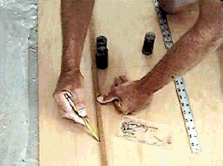
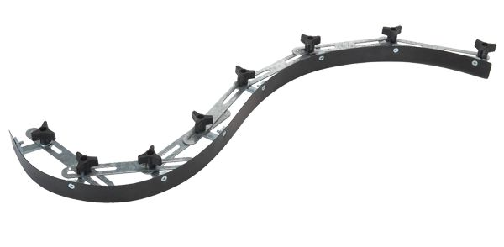
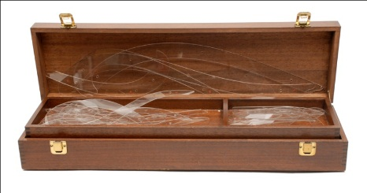
Curves Before Computers
The carpenter’s spline:
  long, narrow strip of wood or metal
  shaped by lead weights called “ducks”
  gives curves with second-order continuity (usually)
Used for designing cars, ships, airplanes etc.
But curves based on physical artifacts cannot be replicated well, since there is no exact definition of what the curve is.
Around 1960, a lot of industrial designers were working on this problem.

Slide 3
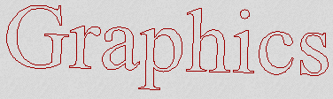
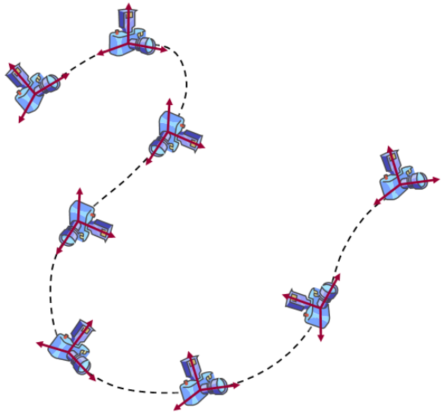
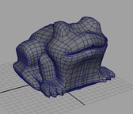
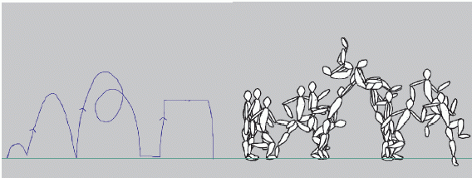
Motivation for curves
What do we use curves for in Computer Graphics?
  Building models
  Movement paths
  Animation
  Truetype fonts
  Vector Graphics, e.g. svg, pdf, Flash
[Matthew]

Slide 4
Motivation for curves
Advantages of using curves
  A few coefficients (just a few numbers) can represent a curve
  e.g., small data storage and data transmission
  No Aliasing problem in the representation level
  Continuous precise curvature
Disadvantages of using curves
  Computation is needed to convert the curves to polygons or line segments before rendering because the graphics hardware works on triangles and lines
  Slower rendering performance
Note: we may pre-compute the polygons/lines for curves when the program starts.

Slide 5
1. Choosing Mathematical Representation
1. Explicit y = f ( x )
  Function: map each input to one exact output
  What if the curve is not a function?
2. Implicit f ( x , y , z ) = 0
x² + y² - R² = 0
  Hard to work with
3. Parametric ( x(u) , y(u) )
  Easier to work with, since u defined in a range
x(u) = cos 2πu y(u) = sin 2πu
Candidates:

Slide 6
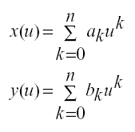
Parametric Polynomial Curves
We’ll use parametric curves where the functions are all polynomials in the parameter.
Advantages
  Easy (and efficient) to compute
  Infinitely differentiable

Slide 7
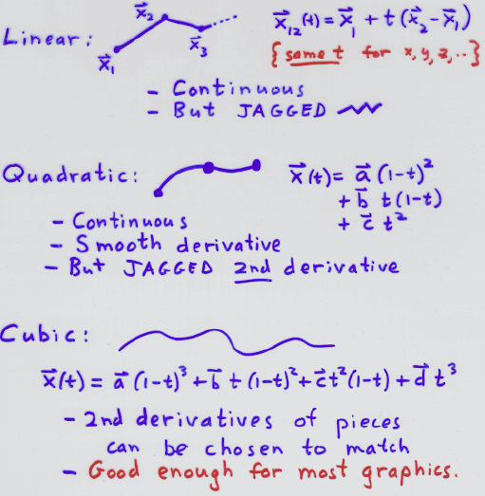


2. Choosing Linear, Quadratic, and Cubic
Linear:
Candidates:
{ same t for x, y, z … }
Note: at joining points
- Continuous
- But JAGGED
C0=G0 continuity
Quadratic:
Need 2 control points
- Continuous
- Smooth derivative
- But JAGGED 2nd derivative
C1, G1 continuity
Need 3 control points
Cubic:
C2, G2 continuity
- 2nd derivatives of pieces can be
chosen to match (between segments)
- Good enough for most graphics.
Need 4 control points

Slide 8
Parametric continuity
C0: matching endpoints
C1: matching endpoints, first derivatives equal
C2: matching endpoints, first and second derivatives equal
Geometric continuity
G0: matching endpoints (G0 = C0)
G1: matching endpoints, curves share tangent direction
G2: matching endpoints, curves share center of curvature

Slide 9
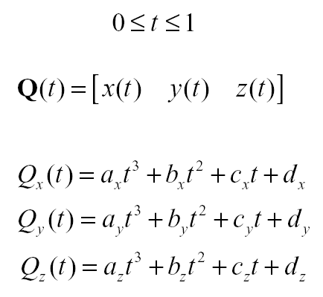
Cubic Curves
Thus, use n=3
For simplicity, we define each cubic function with the range
x(t) =
y(t) =
z(t) =
Turn this into
matrix form
……

Slide 10
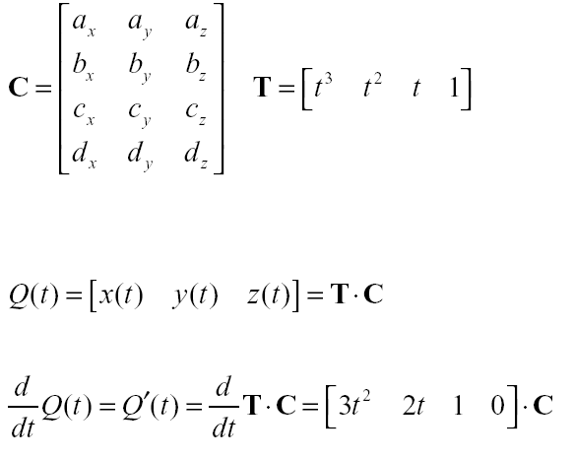
Compact Representation
Place all coefficients into a matrix:
*This is tangent to the curve

Slide 11
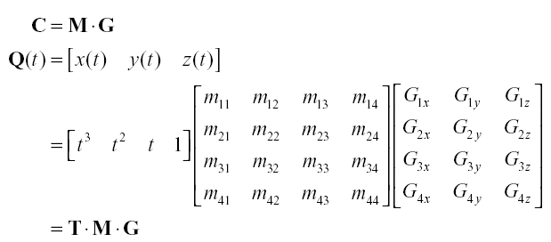
General matrix formulation
Now, we decompose C as a product of the 4x4 basis matrix M and the 4x3 geometry vector G (constraints), e.g. four coordinates.

Slide 12
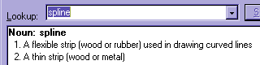
Three Curves to study
Based on these analysis, we will look at the following
curves (splines):
Bezier Curve (formally: Bézier)
B-spline Curve
Catmull Rom Curve
There are many others: Hermite, NURBS, β-spline, etc.
From dictionary:

Slide 13
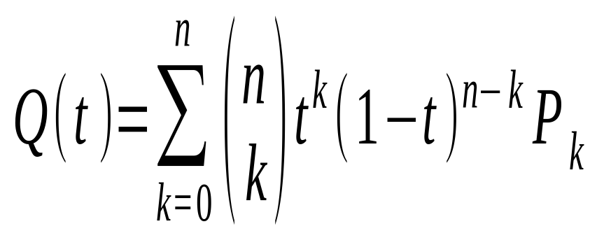
1. Bezier Curve (nth degree)
N+1 control points: P₀, P₁, P₂, …, P_{n}.
P₀
P₂
Simple Interpolation:
P₃
P₁
Put
n=3:
Note: are vectors.

Slide 14
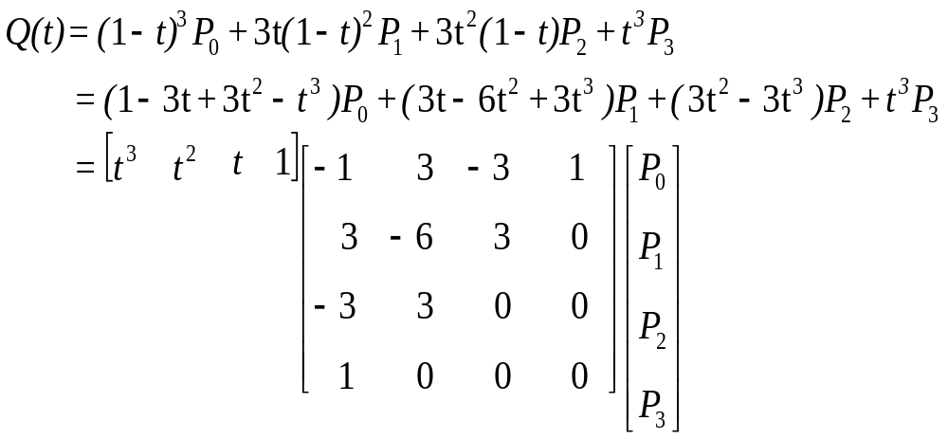
1. Bezier Curve
Geometry
Vector, G
Bezier Basis Matrix, M
Thus, we can formulate Bezier in matrix form.

Slide 15
1. Bezier Curve
We put t =0 and t =1 into Q (t ) and its
first derivative Q ’(t ):
P₀
P₂
P₃
P₁
Note:
1. Q (t) passes through the two end points P₀ and P₃.
2. Tangents at P₀ and P₃ are determined by P₀P₁ and P₂P₃, respectively.

Slide 16
De Castaljau’s algorithm
Another way to compute Q(t)
General Form:
P₁₀ = ( 1 – f₁₀(t) ) P₀ + f₁₀(t) P₁
P₁₁ = ( 1 – f₁₁(t) ) P₁ + f₁₁(t) P₂
P₁₂ = ( 1 – f₁₂(t) ) P₂ + f₁₂(t) P₃
P₂₀ = ( 1 – f₂₀(t) ) P₁₀ + f₂₀(t) P₁₁
P₂₁ = ( 1 – f₂₁(t) ) P₁₁ + f₂₁(t) P₁₂
Q(t) = ( 1 – f₃(t) ) P₂₀ + f₃(t) P₂₁
Note:
Here, we need to determine
f₁₀, f₁₁, f₁₂, f₂₀, f₂₁, and f₃.
P₀
P₁
P₂
P₃
f₁₀
f₁₁
f₁₂
P₁₀
P₁₁
P₁₂
f₂₀
f₂₁
P₂₀
P₂₁
f₃
Q(t)

Slide 17
De Castaljau’s algorithm
We have f10, f11, f12, f20, f21, and f3
all equals to t for Bezier Curve.
P₁₀ = ( 1 – t ) P₀ + t P₁
P₁₁ = ( 1 – t ) P₁ + t P₂
P₁₂ = ( 1 – t ) P₂ + t P₃
P₂₀ = ( 1 – t ) P₁₀ + t P₁₁
P₂₁ = ( 1 – t ) P₁₁ + t P₁₂
Q(t) = ( 1 – t ) P₂₀ + t P₂₁
P₀
P₁
P₂
P₃
t
t
t
P₁₀
P₁₁
P₁₂
t
t
P₂₀
P₂₁
t
Q(t)
Note: this is useful for subdividing the Bezier Curve (see the implementation section)

Slide 18

De Castaljau’s algorithm
Illustration of steps to compute Q(t) :
P₁₁
P₂₁
P₁₂
Q(t)
P₂₀
P₁₀
P₀, P₁, P₂, P₃
P₁₀, P₁₁, P₁₂
P₂₀, P₂₁

Slide 19
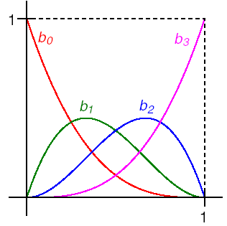

Bernstein polynomials
On the other hand, the coefficients of the control points are a set of functions called the Bernstein polynomials (blending functions).
For example, Bezier curve equation can be formulated as:
t
t
P_{i}
where
b₀(t) = (1 – t ) ³
b₁(t) = 3t (1 – t ) ²
b₂(t) = 3t ² (1 – t )
b₃(t) = t ³
0
t

Slide 20
Convex Hull Property
Useful properties on the interval [0,1]:
each Bernstein polynomial is between 0 and 1
sum of all four is exactly 1 (a.k.a. , a “partition of unity”)
These together implies that the curve lies within the convex hull of its control points. (convex hull is the smallest convex polygon that contains the control points)
P₂
P₀
P₃
P₁

Slide 21
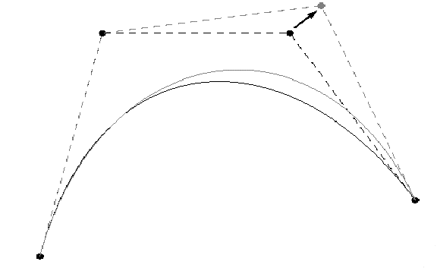
Local Control
One problem with Beziers is that every control point affects every point on the curve (except the endpoints)
Moving a single control point affects the whole curve!
We’d like our spline to have local control, that is, have each control point affect some well-defined neighborhood around that point.

Slide 22
Joining Bezier Curves (C0)
Joining two Bezier Curves (7 control points for 2 segments):
P₀
P₂
P₄
P₃
P₁
P₅
P₆
We can have C₀ continuity at P₃ , but C₁ not always guaranteed.

Slide 23
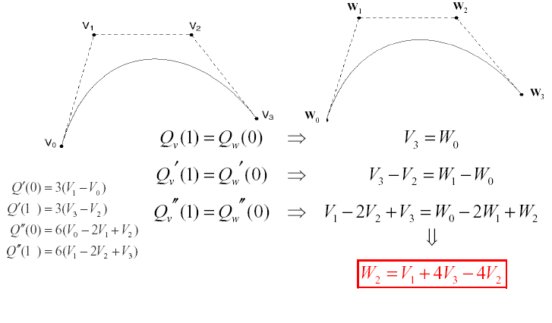
Joining Bezier Curves (C2)
Suppose we want to join two cubic Bezier curves (V0,V1,V2,V3) and (W0,W1,W2,W3) so that there is C2 continuity at the joint.
Note: Only W3 is free to choose

Slide 24
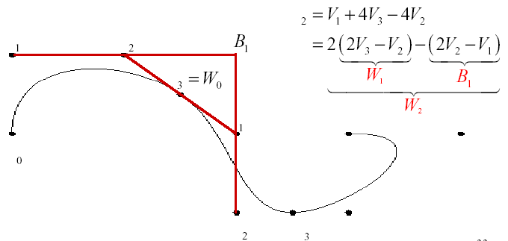
Continuity
Let’s try to get some geometric intuition about what this last continuity equation means.
Note that V3=W0 must be between V2 and W1
V1 relates to W2 similarly
Trick: interpret 2W1-B1 as W1+(W1-B1)
(think about it geometrically)
W
V
V
V
W
V
W
W

Slide 25
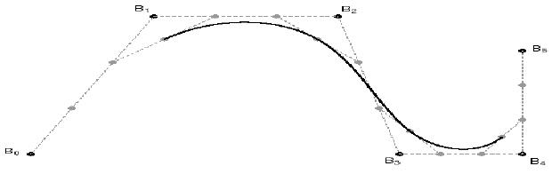
2. B-Spline
Instead of specifying the Bezier control points V’s themselves, let’s specify the corners in order to build a C2 continuous spline.
These are called B-splines. The starting set of points are called de Boor points. We can convert between B-spline and Bezier curve.
Three B-Splines are shown here: (B_{0,} B_{1,} B_{2,} B₃) and (B_{1,} B_{2,} B_{3,} B₄) and (B_{2,} B_{3,} B_{4,} B₅):
V₁
V₂
V₀
V₃

Slide 26
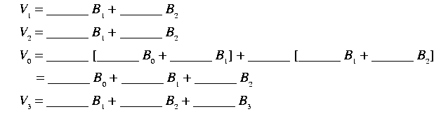
2. B-Spline
When joining two B-Splines, e.g., 6 control points gives 3 segments
Three B-Splines are shown here: (B_{0,} B_{1,} B_{2,} B₃) and (B_{1,} B_{2,} B_{3,} B₄) and (B_{2,} B_{3,} B_{4,} B₅):
V₁
V₂
V₀
V₃
Note: we have C₀, C₁, and C₂ continuities at the shared point.

Slide 27
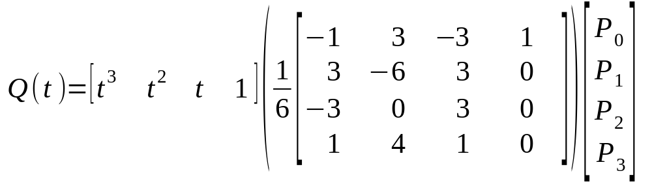
2. B-Spline
Geometry
Vector, G
B-Spline
Basis Matrix, M
B-Spline control points

Slide 28
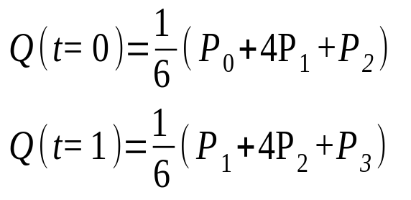
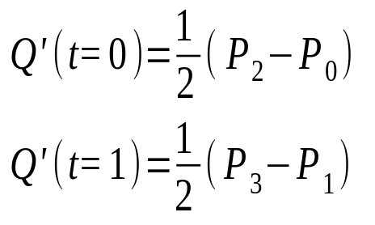
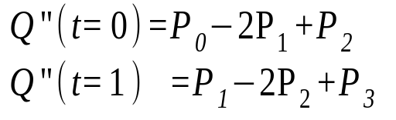
2. B-Spline
Properties of B-Spline Curve:
Bad start points (curve doesn’t start there)
Each segment determined by four control points
One control point may affect in as many as four segments
Perfect 2nd derivatives (matches when joining two B-splines)
Has the Convex Hull Property as Bezier splines

Slide 29
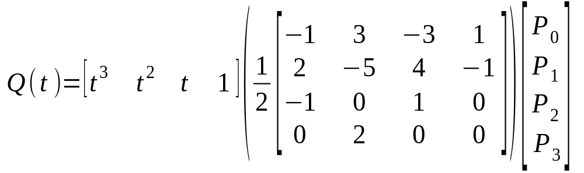
3. Catmull Rom Curve
Note: one problem with B-spline is that it does not go through control points.
So… we have…
Geometry
Vector, G
Catmull Rom
Basis Matrix, M

Slide 30
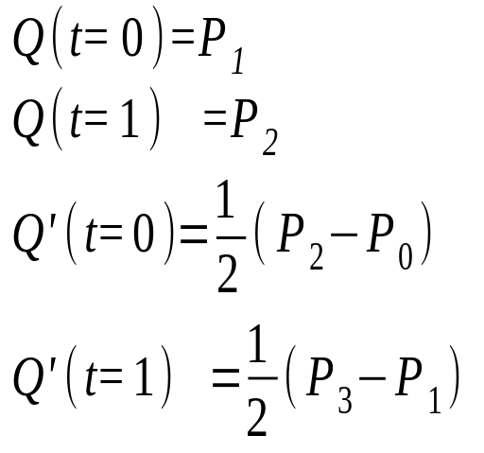
3. Catmull Rom Curve
We put t =0 and t =1 into Q (t ) and its first derivative Q ’(t ):
P₁
P₂
P₀
P₃
Note:
1. Q (t) passes through P₁ and P₂.
2. Tangents at P₁ and P₂ are determined by P₀P₂ and P₁P₃, respectively.

Slide 31
3. Catmull Rom Curve
Joining two Catmull Rom Curves
(5 control points for 2 segments):
Control points of Segment 1: (P_{0,} P_{1,} P_{2,} P₃)
Control points of Segment 2: (P_{1,} P_{2,} P_{3,} P₄)
P₁
P₂
C₀
P₀
P₃
C₁
P₄
We have C₀ and C₁ continuities at P₂ , but C₂ is not guaranteed.
Simple to compute; useful for camera motions.

Slide 32
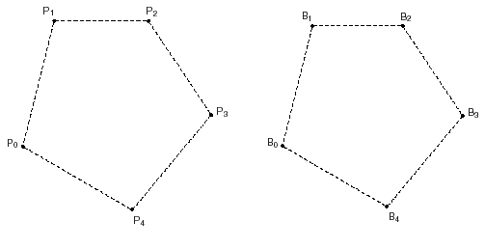
Closing the loop
What if we want a closed curve, i.e., a loop?
Exercise:

Slide 33
Summary
Choice: 1) Parametric functions and 2) Cubic functions
The formulation of the basis matrix and the geometry vectors
General procedure for computing points on curve
Properties of Bezier splines, B-Splines, and Catmull Rom splines
Bernstein polynomials (Blending Functions) and Convex Hull property
Enforcing continuity across multiple curve segments

Slide 34
Implementation Issues
Recursive method for drawing splines
Drawing curves in OGL:
  Evaluators
  Display Lists

Slide 35
Recursive Method for Drawing Splines
int step ; float t ; Vector pos ;
glBegin ( GL_LINE_STRIP ) ;
for ( step = 0 ; step <= 200 ; step ++ )
{
t = step / 200.0 ;
pos = Q(t) ;
glVertex3dv ( & pos ) ;
}
glEnd() ;
This is very straightforward, but…
How many steps we should have?

Slide 36
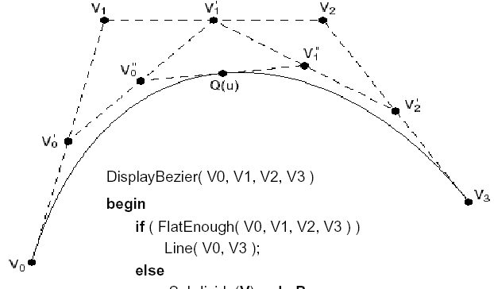
Recursive Method for Drawing Bezier
Pseudocode:
void
DrawBezier ( V0, V1, V2, V3, Error e )
{
if FlatEnough (V0, V1, V2, V3, e )
DrawLine ( V0, V3 ) ;
else
{
Subdivide ( V, L, R );
DrawBezier ( L0, L1, L2, L3, e ) ;
DrawBezier ( R0, R1, R2, R3, e ) ;
}
}
L contains: V_{0,} V₀’, V₀’’, Q(u)
R contains: Q(u), V₁’’ , V₂’, V₃
*Note: subdivide applies De Castaljau’s algorithm.

Slide 37
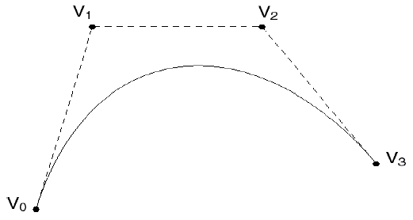
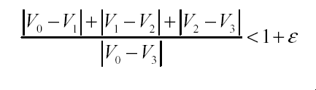
Recursive Method for Drawing Bezier
Measurement of Flatness:
E.g., compare the total length of control polygon to the length connecting the endpoints:

Slide 38
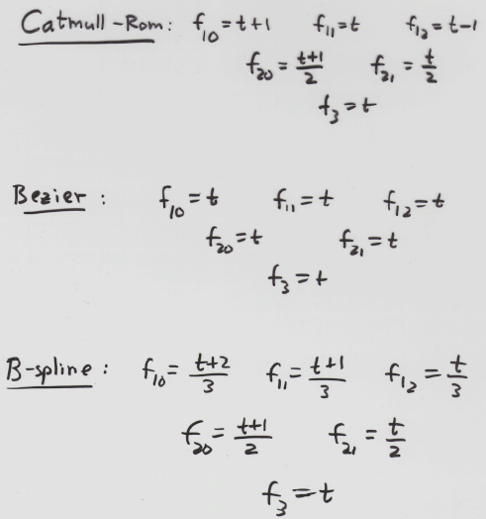
Summary: De Castaljau’s algorithm
Bezier:
f_{ij} = t
Catmull-Rom:
B-spline:

Slide 39
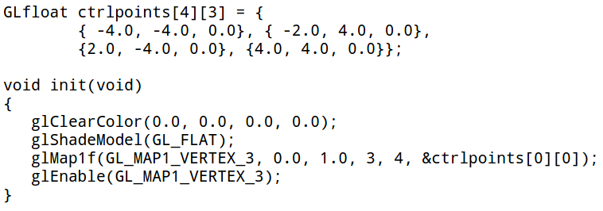
2. Drawing Curves in OGL
OGL provides Evaluators, which allows us to evaluate spline vertices, texture coordinates, colors, normals, etc. in the graphics hardware
Two steps:
1. Setup the Curve by telling OGL your control points, etc.
> glMap1f ( … ) ;
> glEnable ( GL_MAP1_VERTEX_3 ) ;
2. Rendering (substitute glVertex by glEvalCoord), e.g.
> glBegin ( GL_LINE_STRIP ) ;
> for ( t = 0.0 to 1.0 ) glEvalCoord ( … ) ;
> glEnd () ;
(Details: see Evaluator Chapter or sample code on the web)
Doc: http://www.glprogramming.com/red/chapter12.html
Bezier's ctrl points

Slide 40
2. Drawing Curves in OGL
To speedup the rendering, you could also use Display List:
The idea of display list is to store the OGL commands for later execution.
E.g.,
  You can cache “glRotate … glBegin … glVertex… glEnd” (e.g., your geometry, if it is static) in a display list and these OGL commands will (usually) be stored as machine-level commands in the graphics hardware (but this varies from implementation to implementation).
  Thus, when you can call the display list again and again, the hardware can apply these cached and already-converted commands directly.
  (See the Display List chapter in the Red book for details)

